Slide 1
Legal developments and impact on Policy advocacy, and practice in Israel
Prof. Ariela Lowenstein, University of Haifa Israel
The Role of the Legal System in the case of
Elder Abuse & Neglect

Slide 2
Charter of Fundamental Rights
Article 25 of the Charter of Fundamental Rights, the European Union
recognised and respected the rights of older people to lead a life of
dignity and independence, and to participate in social and cultural life.
Accordingly, the challenge today and for the future will be to tackle the demographic change in an affirmative way

Slide 3
Legal developments and impact on Policy, advocacy, and practice in Israel
The main thrust in Israel to deal with Elder Abuse came through advocacy by:
-Eshel*
-The Ministry of Social Welfare
-The Ministry of Health
-National Insurance Institute
* The Ass. for Planning and Development of Services for the Aged in Israel

Slide 4
Needed Action at National Level
Elder abuse can only be effectively prevented by action at the
appropriate national level
Thus, in order to combat abuse, policy action, in the form of a
National Action Plan must be drawn
Such a plan should include general guidelines and relevant
legal bases to be established

Slide 5
A National Plan for Care of the Older
Population
Currently the Israeli Gerontological Society, with involvement of the
chair, Prof. Brick and several members, including Prof. Lowenstein,
prepared A National Plan for Care of the Older Population, relating to
major issues in the field of aging, including Elder abuse and neglect.

Slide 6
Parliamentary Committee
. A special Parliamentary Committee had been established,
headed by the vice-chair of the Israeli Parliament.
This Parliamentary Committee met bi-weekly and discussed the various
issues within the suggested plan.
In the area of elder abuse & neglect the following were suggested,
focusing on: Prevention, Identification and Treatment

Slide 7
Elder Abuse Awareness
The following programs were approved :
Acquiring knowledge through National Data Collection
Developing community interventions pilot programs
Introducing new regulations and protocols in the Health and Welfare systems
Developing new Legislation
Establishing a “Help Line” for EA victims
Developing training programs and case materials

Slide 8
Legislative Developments
Legislative Developments Prior to 2016 Guardianship Law Reform
Israel has a rich history of legislative attempts to address the phenomena of elder abuse and neglect
It can be summarized as a "legislative-generational" developmental process
Invited Chapter. Lowenstein, A. & Doron, I, - Elder Abuse in Israeli Society – legislative Acts and Special Services. (ED.) M. Phelan. A book chapter for the book on: Combating Elder Abuse

Slide 9
legislation, policy, research and services
Four "legislative generations
“Paternalism and social intervention" Introduction of laws during the first years of Israel's existence
1 - The Law of Legal Competence and Guardianship, 1962

Slide 10
Legislative Generations
2. “Criminal law and mandatory reporting" Mainly a criminal approach
New legislation encouraging: awareness, knowledge, training and empowerment of professionals working with abused elders
  Amendment 26 to the Penal Code, 1989, "Injury to the helpless". Also identified Elders as susceptible to injury

Slide 11
Legal Development – Mandatory Reporting
A major addition (1989) to Criminal Law of 1977 - for first time incorporating a specific reference to EA of minors and "helpless persons" (older persons part of this group); in its various forms (physical, mental & sexual) defined as a unique criminal offence.
It introduced, first time, a very broad mandatory reporting mechanism,
mandating not only professionals, but any person with reasonable suspicion on EA
to report it either to a police or welfare officer.

Slide 12
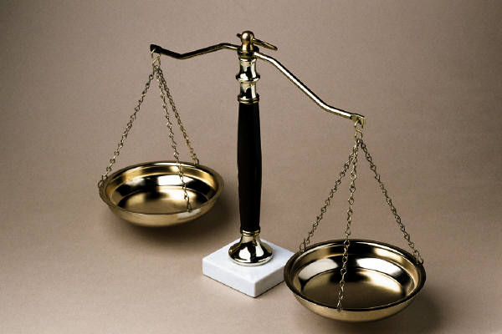
Legislative Generations
Amendment 26 to the Penal Law shows some
legislative progress on EA.
Thus, the Ministry of Social Welfare developed special
courses to train needed welfare officers-senior social
workers for the courts

Slide 13
A new broad legal approach: family violence laws.
A most important outcome - the enactment of Israel’s
    Violence in the Family Law of 1991.
  For the first time it authorized victims of family violence to access
  ‘Family Courts’ in an independent manner, in order to receive
  protective orders against their predator

Slide 14

Legislative Generations
3. “Protection and Therapy within Family Violence"
A response to empirical data on family violence and the system’s failure to deal with it.
  The Law for Prevention of Violence in the Family, 1991 - also enables to consider older persons who suffer from family violence

Slide 15
Legislative Generations
4. Amendment 7 of the Law for Prevention of Violence in the Family, 2001,
The law emphasizes professionals’obligation to provide
victims of EA information in order to get help and care.

Slide 16
The Generational Development of Israeli Legislation
 | Time | Rationale | Legal Foci of Power | Statutory Example | Elder Specific?
Gen. 1 | 1950s-1960s | Social control & Protection of helpless populations | Social welfare officers | Legal Capacity and Guardianship Law 1962 | No – part of "helpless populations"
Gen. 2 | 1980s | Deterring and punishing + Reporting | Police/ Criminal Justice | Criminal Law (Amendment), 1989 | No – part of "helpless populations"
Gen. 3 | 1990s | Removal and Treatment | The Victims | Prevention of Family Violence Law 1991 | No – part of victims of family violence
Gen. 4 | 2000s | Mix: Awareness, Early detection; Social intervention; criminal deterrence; | Mix: Older persons & Professionals | Ministry of Health Directives 2003-5 | Yes

Slide 17
A significant development in Israeli legislation
In last 3 years, after political struggle, Israeli Parliament enacted a major law reform - relating to EA & Neglect: in the field of Adult Guardianship
Three main elements were included: 1. Establishing a Supportive Decision Making Mechanism as an alternative to Formal Guardianship
2. Establishing Continuing Power of Attorney for property and personal care, as an alternative to formal guardianship
3. Reforming existing guardianship regime to minimize its scope, and transforming it to an option of last resort

Slide 18

Legislative generations
The question is: how were legislative developments
translated into advocacy, research and practice?

Slide 19

Awareness, policy and services
A hot-line for elders exposed to abuse was established.
The volunteers operating it had been especially trained on EA issues.

Slide 20
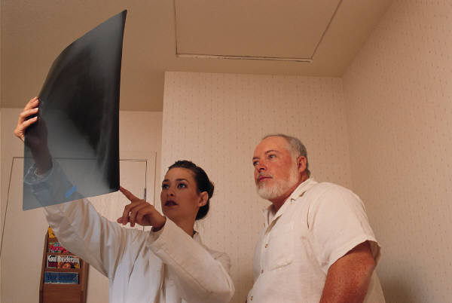
Identifying and Reporting EA in the Health System
The Ministry of Health Director General issued a detailed procedure:
A circular states that one of its aims is “to increase awareness of EA and neglect” phenomenon and “to broaden and deepen identification of and care for aged, from the moment that suspicion is aroused...” (Clause 2.3).

Slide 21
Awareness, policy and services
A national committee was created with members from all
relevant governmental ministries (welfare, health, police),
Academia and NGOs.
A National Forum for inter-organizational coordination
was created by the Welfare Ministry.

Slide 22
Further Needed Steps
An integrative approach is needed to create partnerships between
the criminal-legal system and the health-welfare systems.

Slide 23
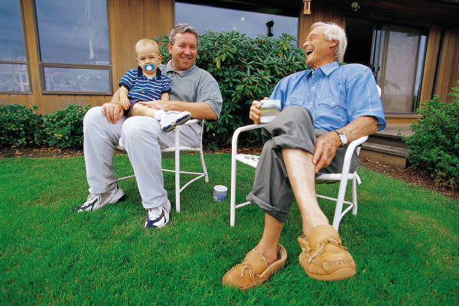
Three main policy issues emerge:
What should be the dominant approach: Criminal-Legal or Social ?
2. What types of professional interventions should be
further developed and implemented?
3. What should be the division of responsibility
between the health and welfare systems?

Slide 24

Thank you

