Slide 1


ONLIFE: Empower hybrid Competences for Onlife Adaptable Teaching in School Education in times of pandemic
ONLIFE- Final Event - Brussels
3 May 2023, European Parliament
Reference Number: 2020-1-PL01-KA226-SCH-095529
Title: ONLIFE Learning Platform
Presenter: Tomasz Szemberg
This project has been funded with support from the European Commission. This PowerPoint reflects the views only of the author, and the Commission cannot be held responsible for any use which may be made of the information contained herein.

Slide 2

Moodle

Slide 3
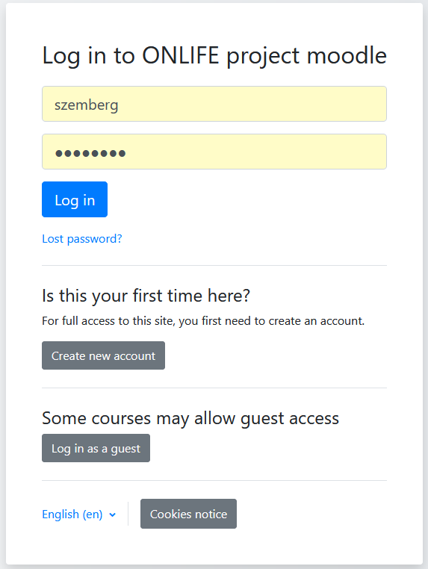
Accessibility

Slide 4
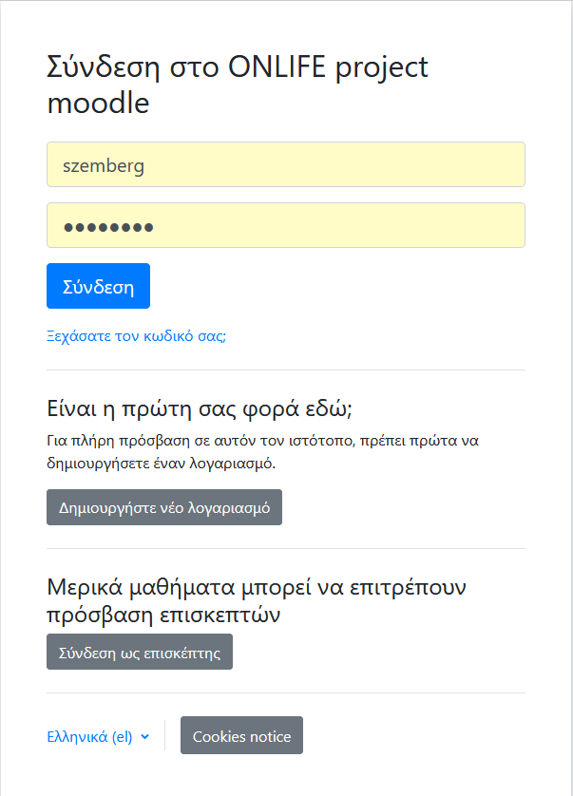
7 languages

Slide 5
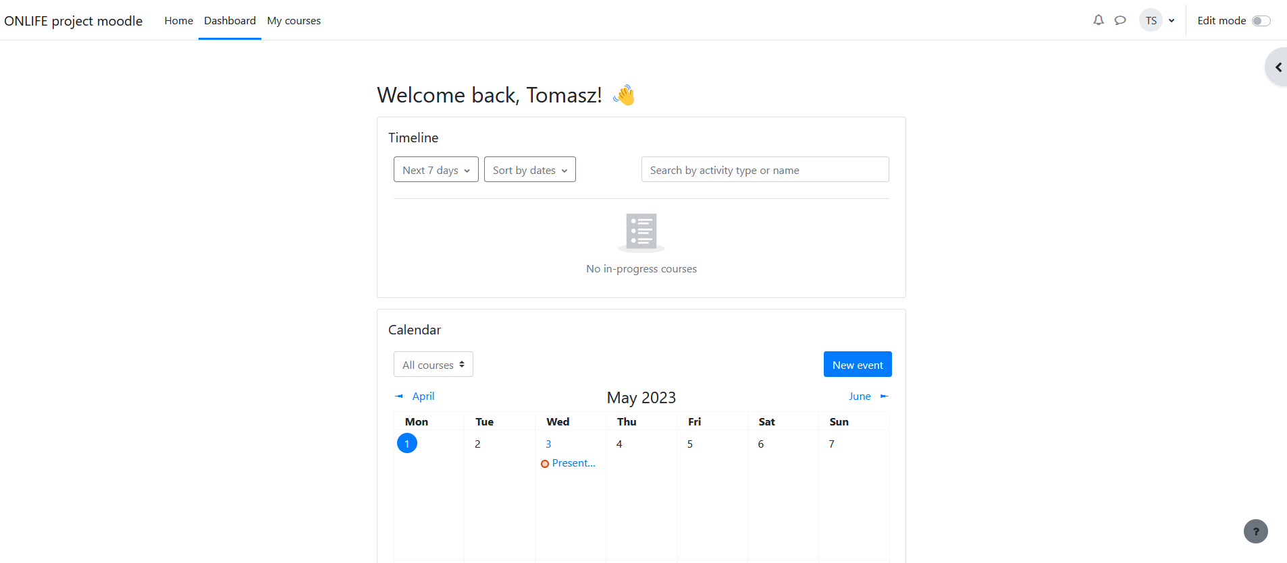
Landing space

Slide 6
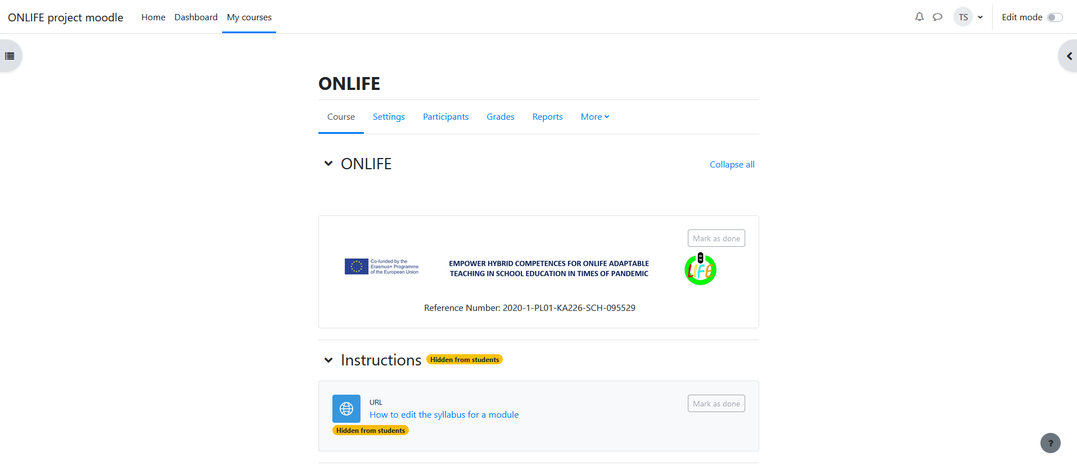
Teacher’s view

Slide 7
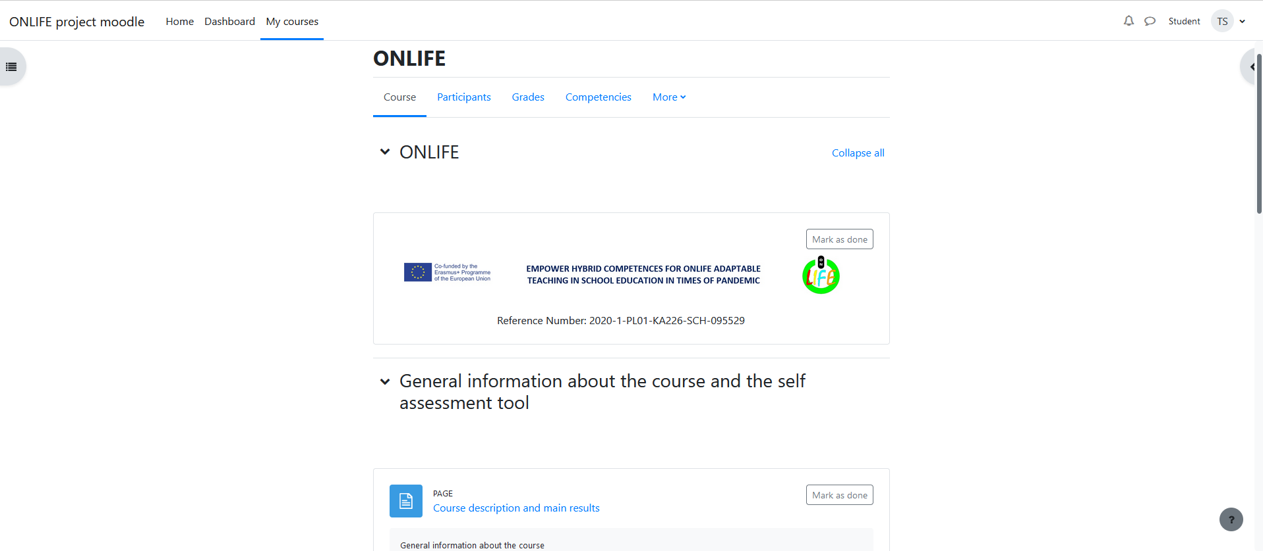
Student’s view

Slide 8
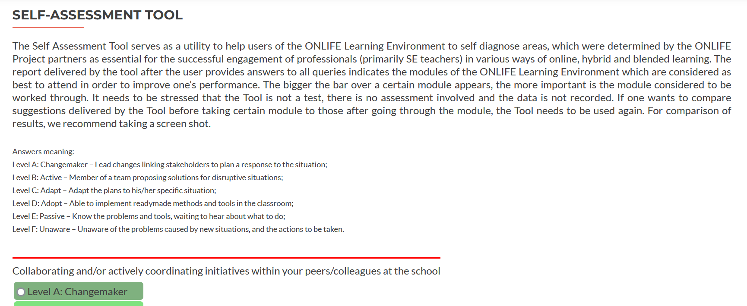
Selfassesment tool

Slide 9
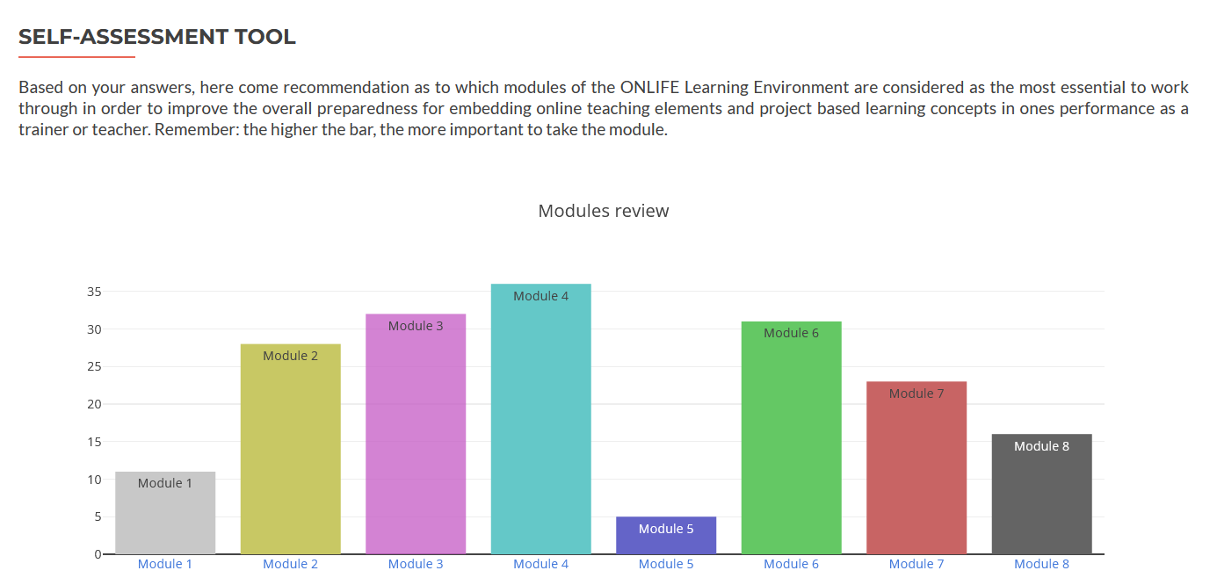
18 questions answered

Slide 10
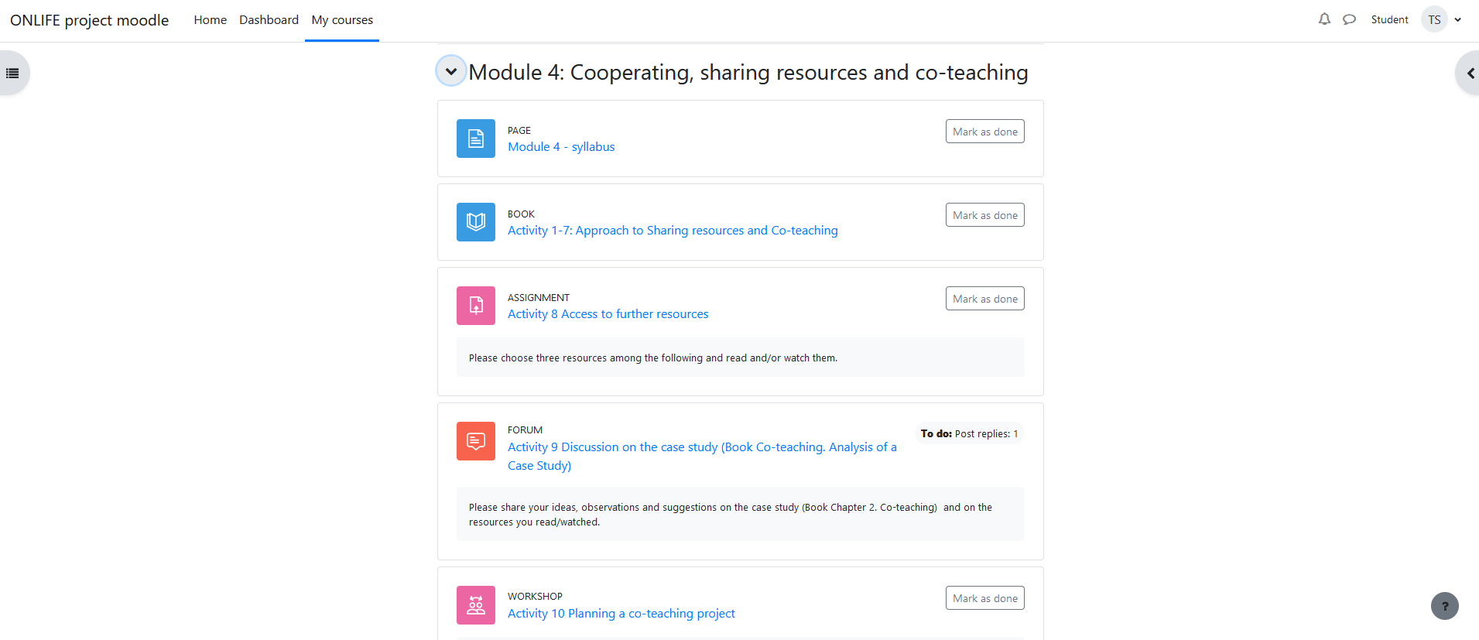
Right to the right module!

Slide 11








The ONLIFE Partners

